Slide 1
XYZ Brewery
Dakota’s Craftiest Brewery

Slide 2
opportunity
According to Fortune.com¹:
US Craft Brew industry is worth $26 billion dollars in 2017
This represents increases of 6.2 billion since 2015
The pace of growth is slowing but the opportunity is large
Craft beer drinkers tend to support local independent breweries
Consumers are becoming more selective
Rising demand for low alcohol by volume (ABV) and flavored beer²
Each market share of .5% = $130 million in revenue
Footnote: 1. data URL=http://fortune.com/2018/03/27/craft-beer-2017-sales/, 2 data URL=https://www.grandviewresearch.com/press-release/global-craft-beer-market

Slide 3
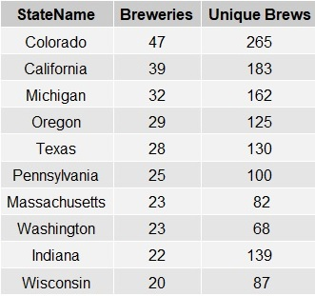
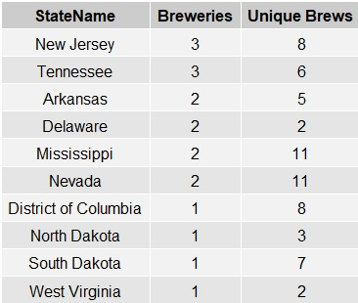
Competitive Landscape
558 craft breweries across the US brewing 2410 unique craft beers
Most Saturated Markets
Least Saturated Markets

Slide 4
Beer Statistics
According to Craftbeer.Com there are 4 key statistics used to describe craft beers
Serving size
International Bitterness Units (IBU)
Bitterness element of a beer’s flavor
Concentration of isomerized alpha acids
Original Gravity/Final Gravity
Sugars in beer available for fermentation before and after fermentation
Affects ABV and sensory intensity
Alcohol By Volume (ABV)
Higher ABV more complex and intensity of flavor
Higher ABV more physical effects
note: https://www.craftbeer.com/craft-beer-muses/craft-beer-by-the-numbers

Slide 5
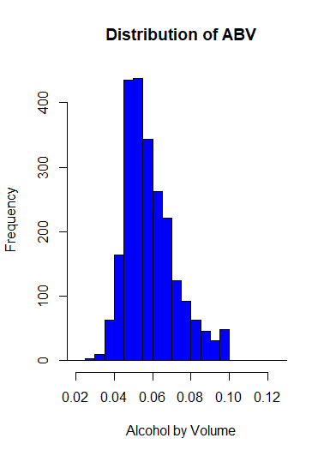
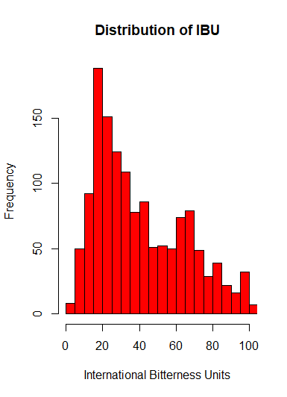
Overall IBU/ABV Production statistics
Mean= 0.0598, Median=.056, Standard Deviation=.0135
Mean= 42.7, Median=35.0, Standard Deviation=25.9
Notes:
Skewed distributions indicate most beer produced is lower ABV and lower IBU

Slide 6
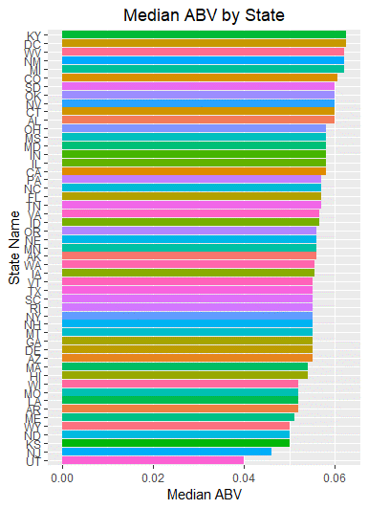
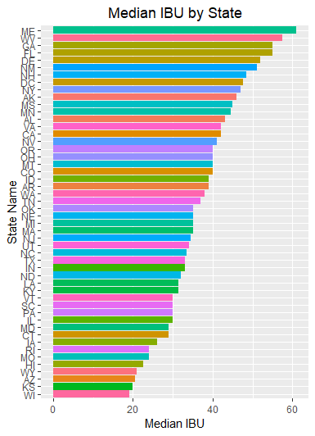
Beer Statistics by State
Notes:
States with Highest Average (median) ABV:
District of Columbia=.0625, Kentucky=.0625, Michigan=.062,
New Mexico=.62, and West Virginia=.62
States with Lowest Average (median) ABV:
Kansas=.05, North Dakota=.05, Wyoming=.05, New Jersey=.046, and Utah=.04
States with Highest Average (median) IBU:
Maine=61.0, West Virginia=57.5, Florida=55.0, Georgia=55.0, Delaware=52.0
States with Lowest Average (median) IBU:
Hawaii=22.5, Wyoming=21.0, Arizona=20.5, Kansas=20.0, and Wisconsin=19.0

Slide 7
Extreme Beers
Highest ABV reported = .128
Lee Hill Series Vol. 5 - Belgian Style Quadrupel, Upslope Brewing Company Boulder, CO
Highest IBU reported = 138
Bitter Bitch Imperial IPA, American Double / Imperial IPA, Astoria Brewing Company Astoria, OR

Slide 8
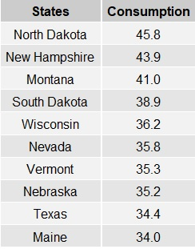
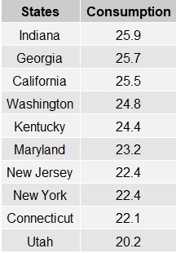
Regional Consumption Rate
States with Highest Gallon Per Adult Consumption
States with Lowest Gallon Per Adult Consumption
Regions with higher consumption rates fall in the least saturated category (ND,SD)
Montana is regionally close.
Competition from Colorado & Wisconsin
note: consumption data from URL=http://scottjanish.com/map-per-capita-gallons-beer-consumed-per-adult-state

Slide 9
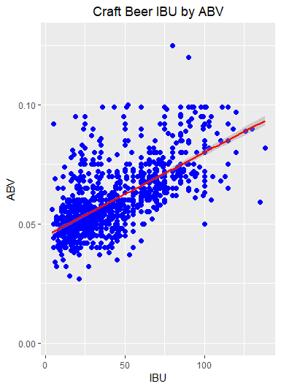
Are IBU and ABV related?
IBU and ABV correlated r=.67, p < .00001
Outliers few high ABV beers
Most beers fall in the low to moderate ABV
Under 5% ABV not likely to have High IBU
Higher ABV > 7.5% still have a full range of IBU’s

Slide 10
Proposal
Build a brewery on the North/South Dakota Border
(e.g. Strasburg, off of I-83 south of Bismarck)
Develop a line of craft beers called “Dakotas”
Median ABV for South Dakota is towards the higher end while North Dakota is lower end
Median IBU is on lower range for North Dakota and no information for South Dakota
Three initial offerings unique and would garner local brand attachment
Higher ABV with lower IBU Dakotas White Out
Moderate ABV with moderate IBU Dakotas Road Plow Blast
Moderate ABV with lower IBU Dakota Winter Nights
5 Year Goal: Regional adoption of 40%, US market Share of .025%

